Slide 1

Golden Eye App Guide V1.1
User Manual
Feb 2025
© 2025 Vision Group

Slide 2

USER MANUAL
© 2025 Vision Group

Slide 3

Download Link
Android application link
https://play.google.com/store/apps/details?id=com.unilever.goldeneye&hl=en&gl=us&pli=1
ios application link
Development is in Progress
© 2025 Vision Group

Slide 4
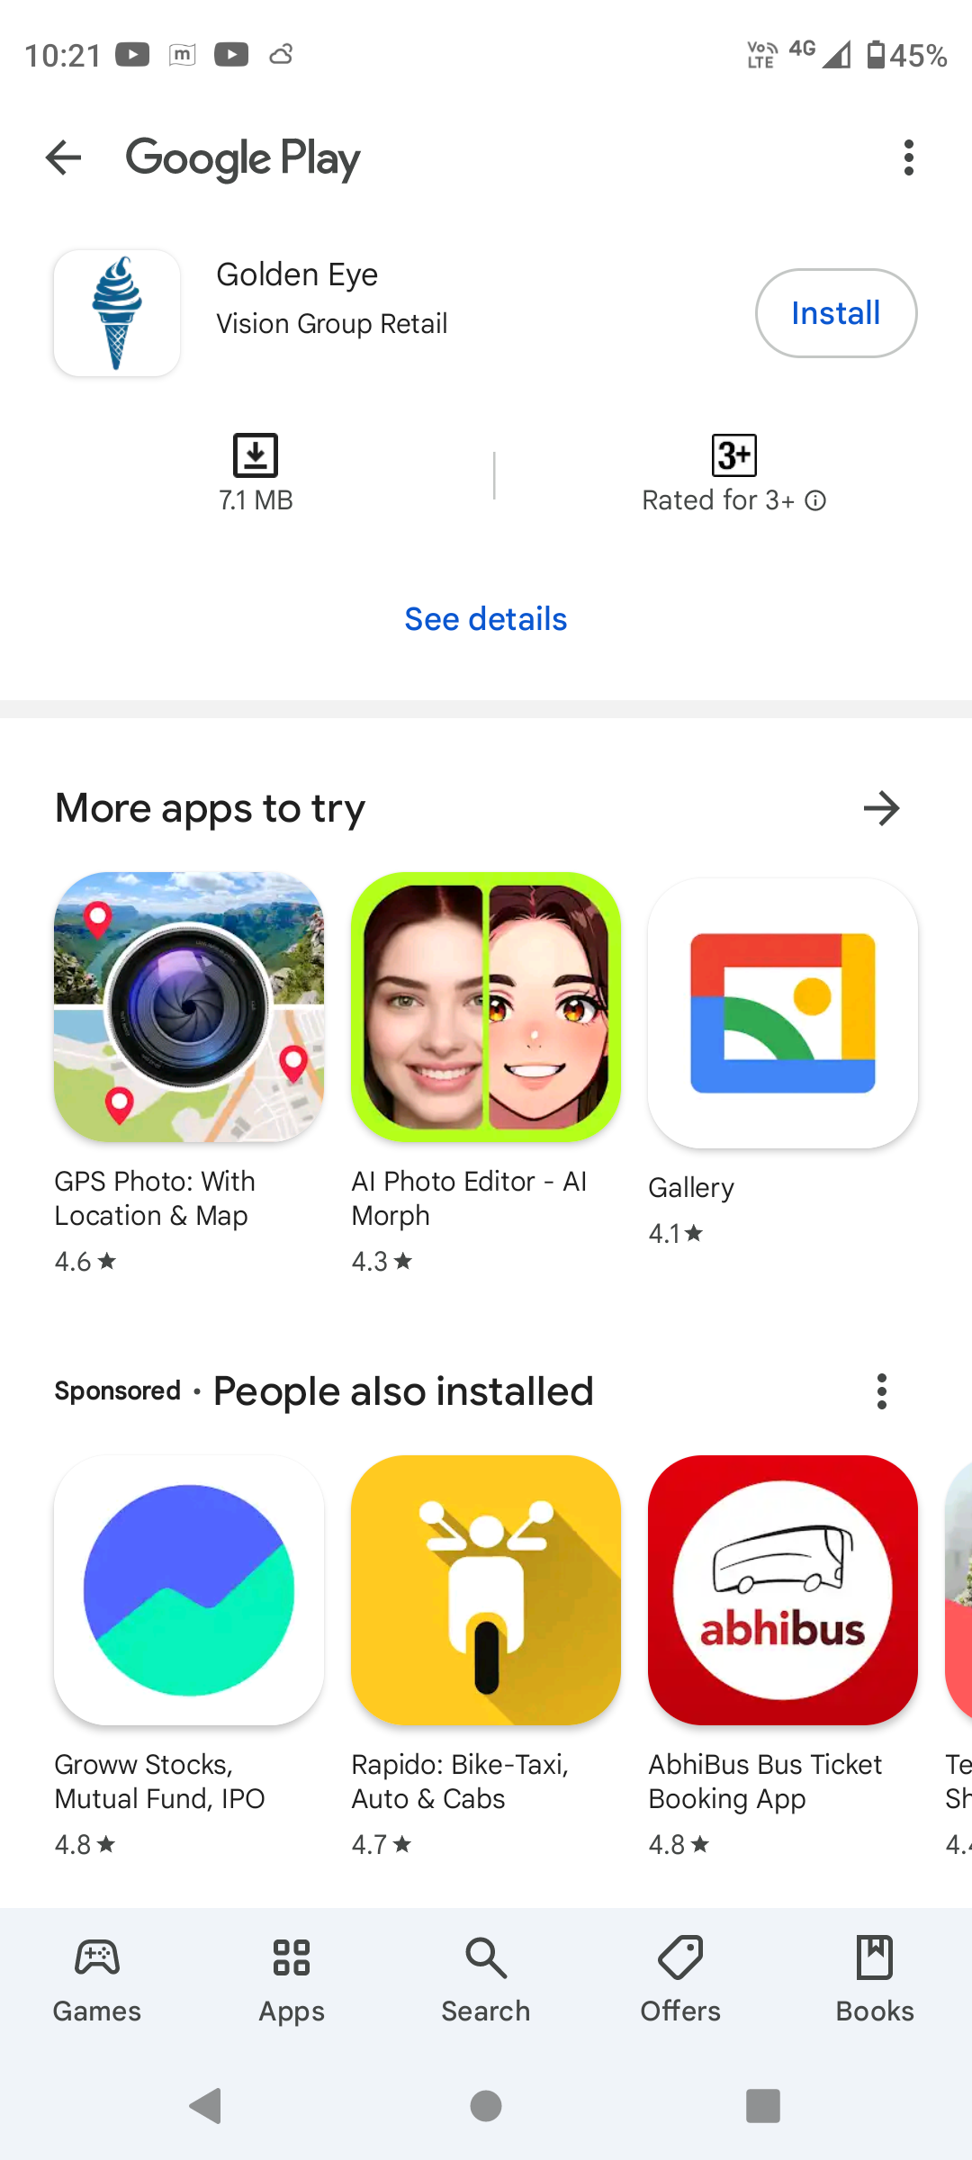
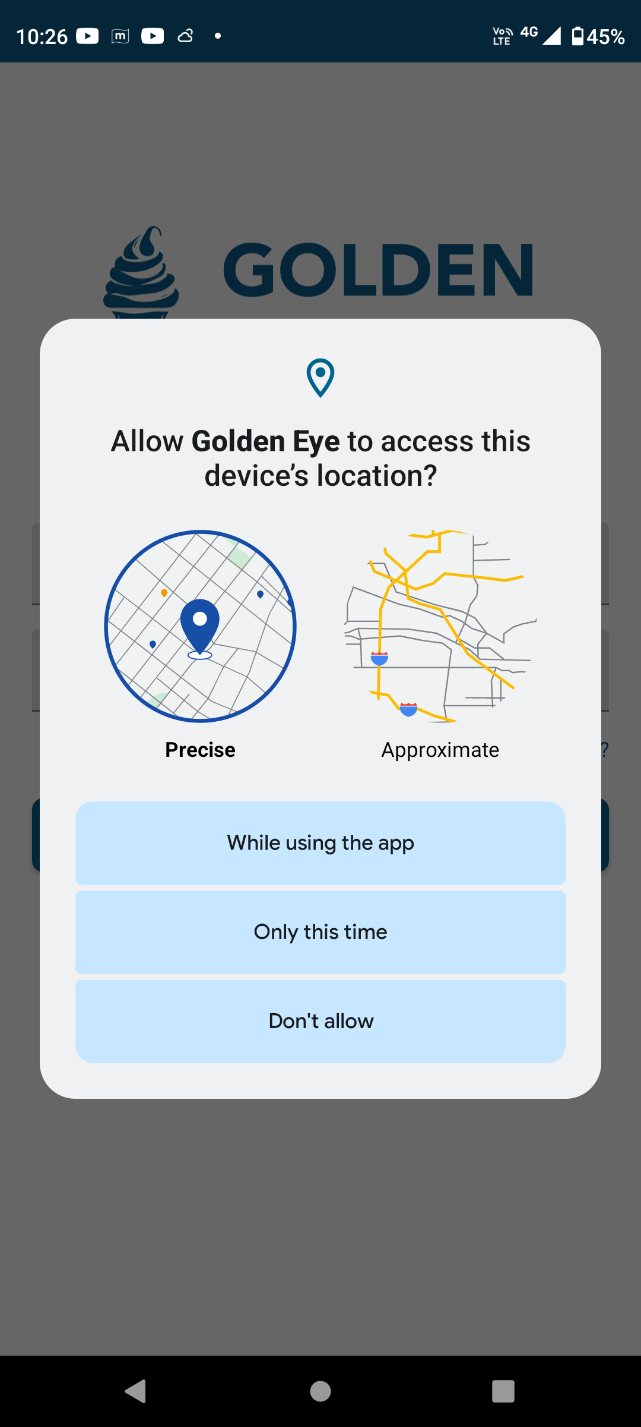
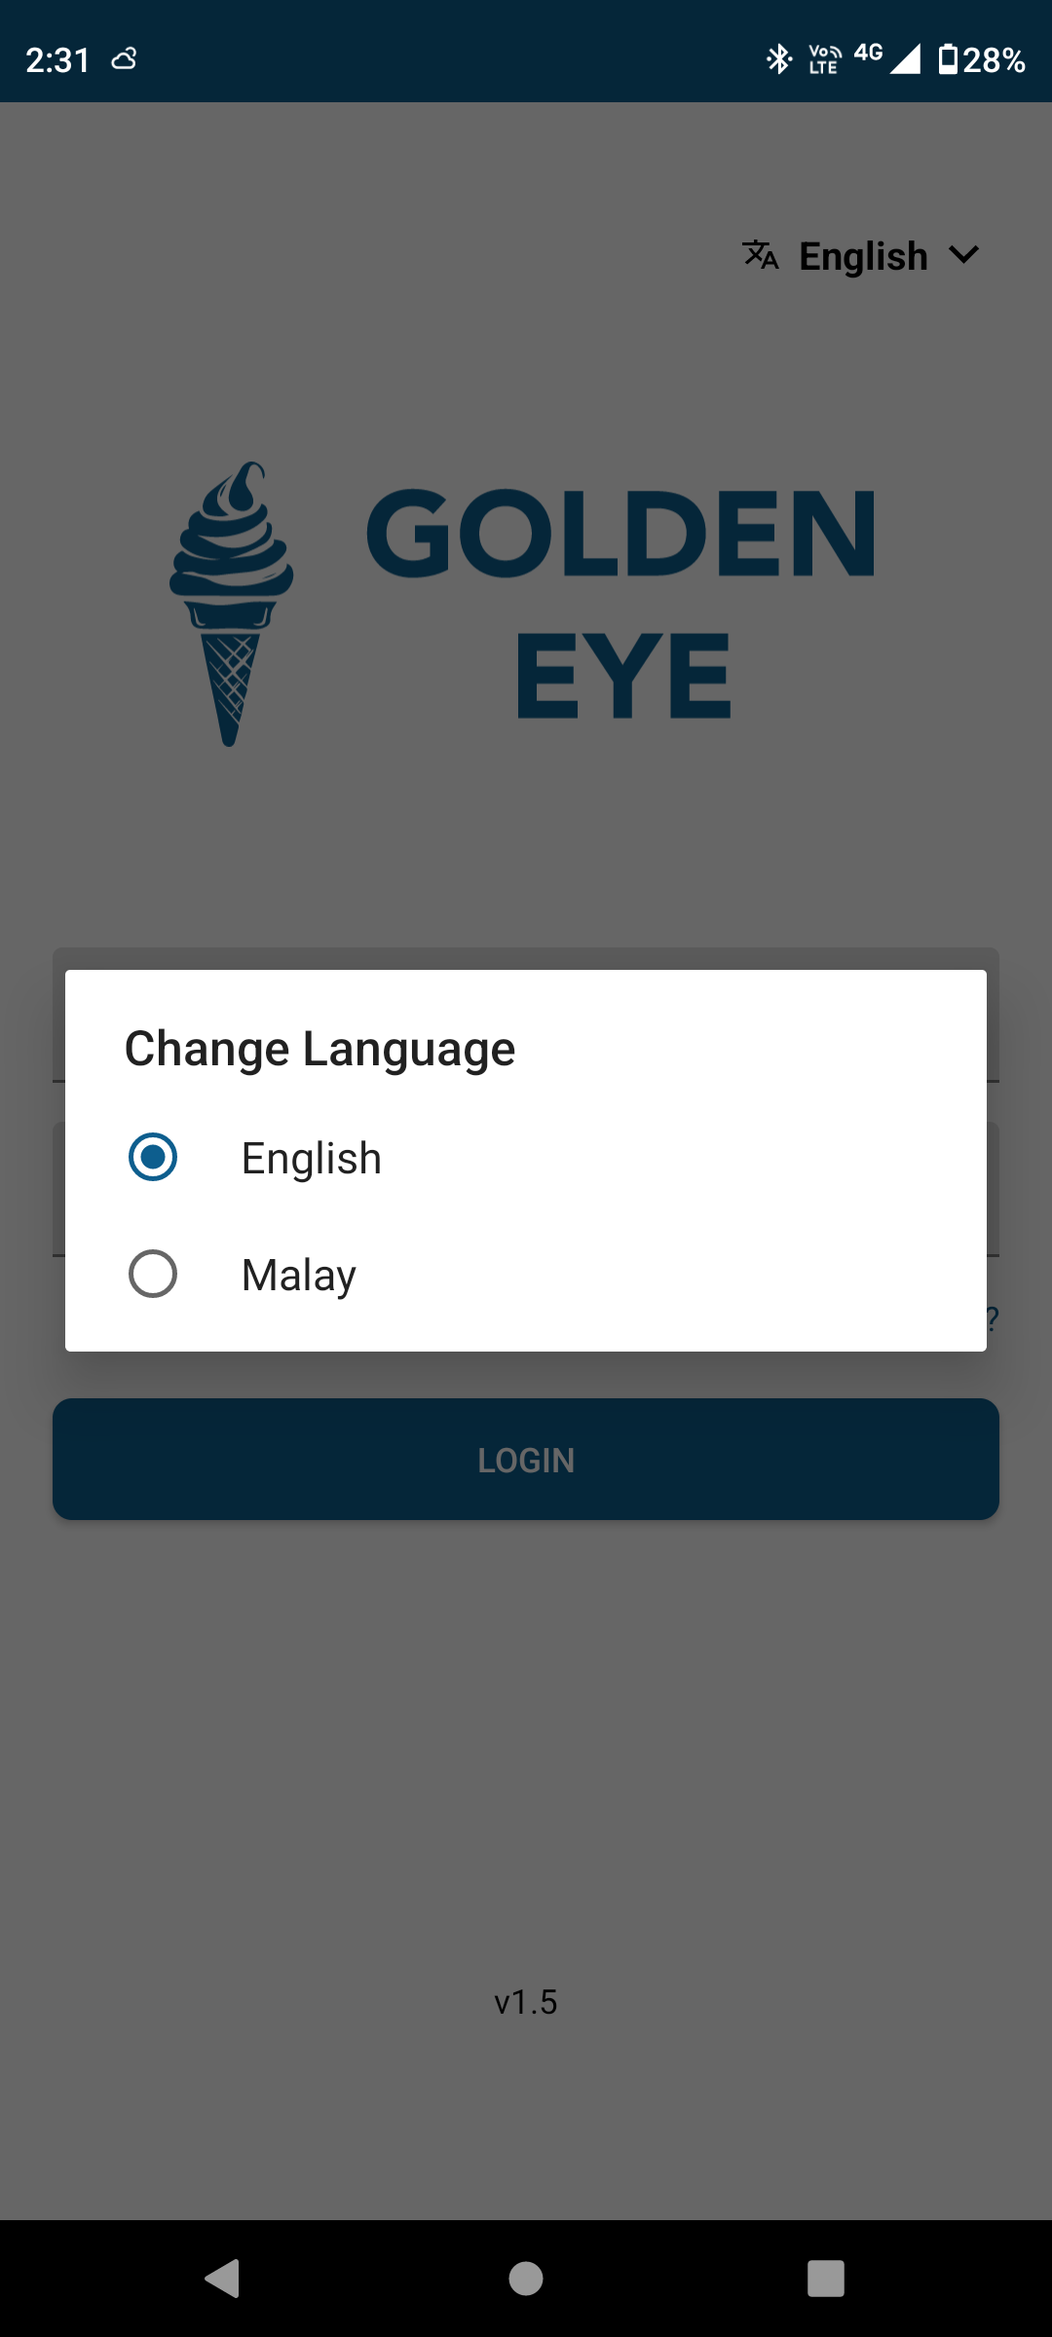
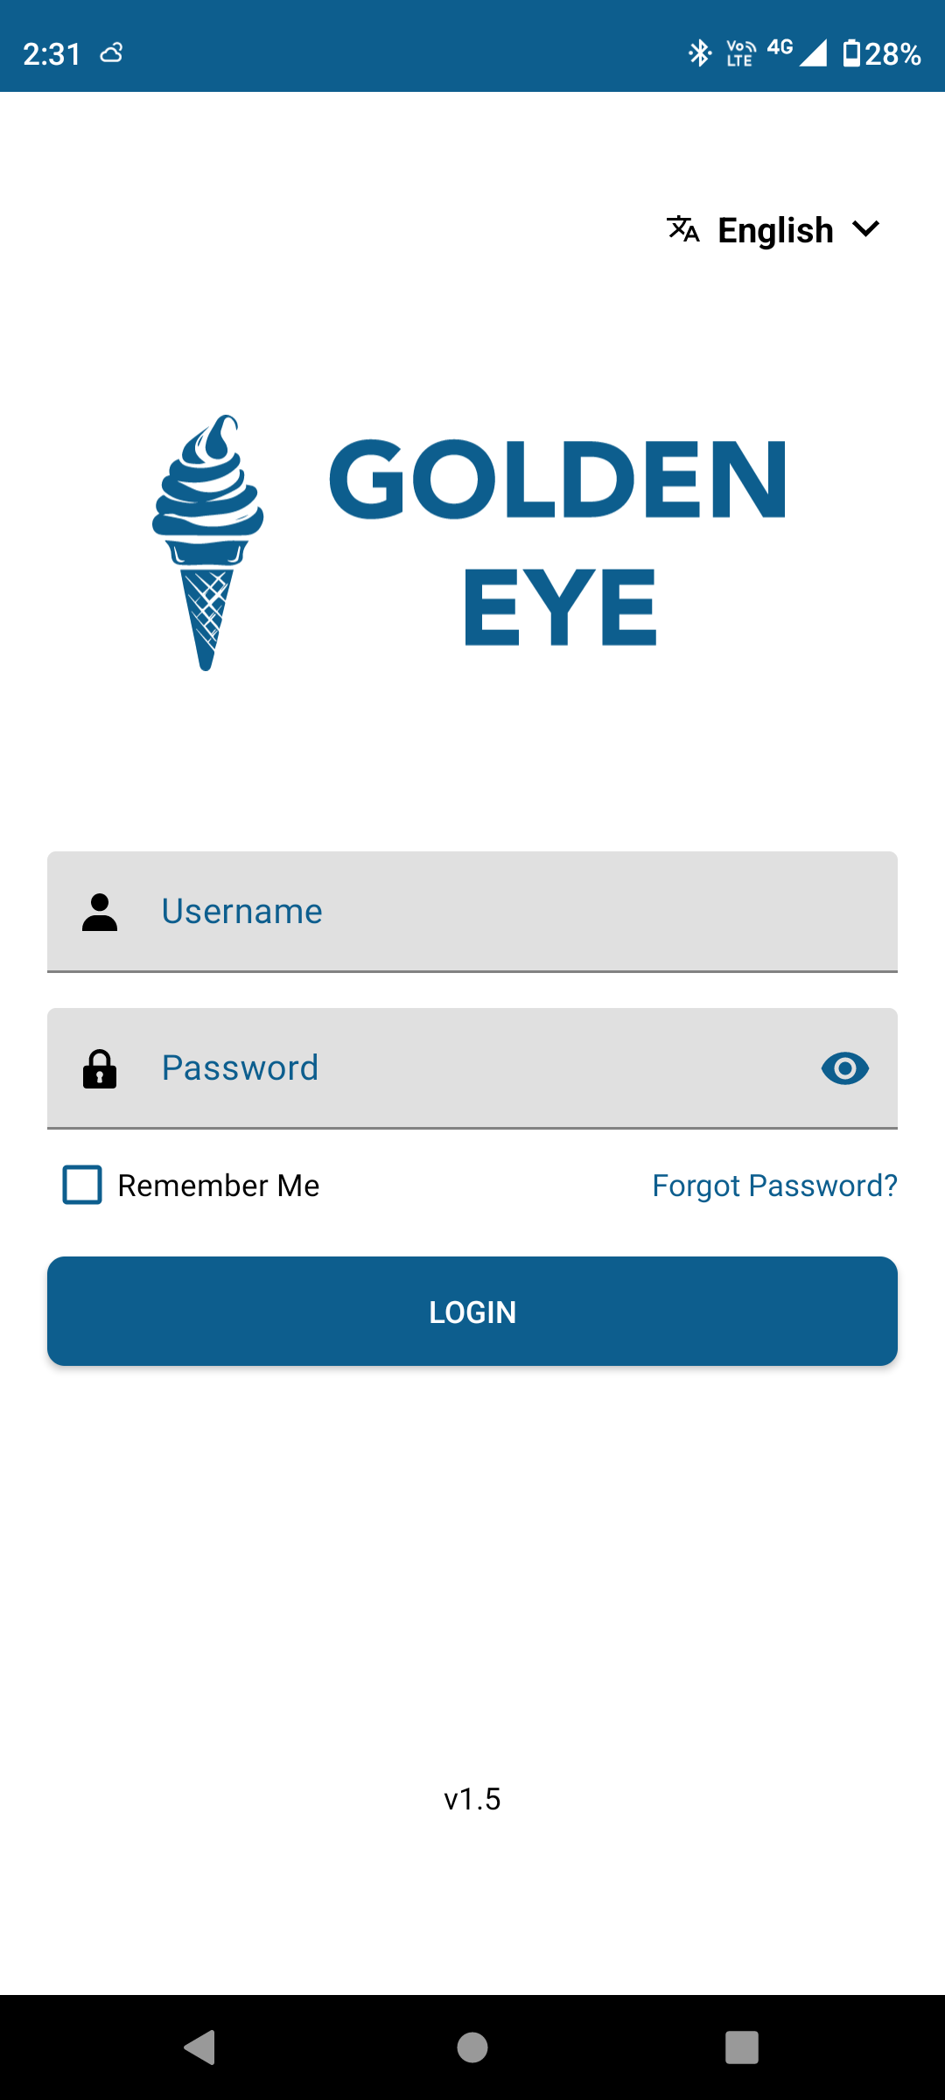
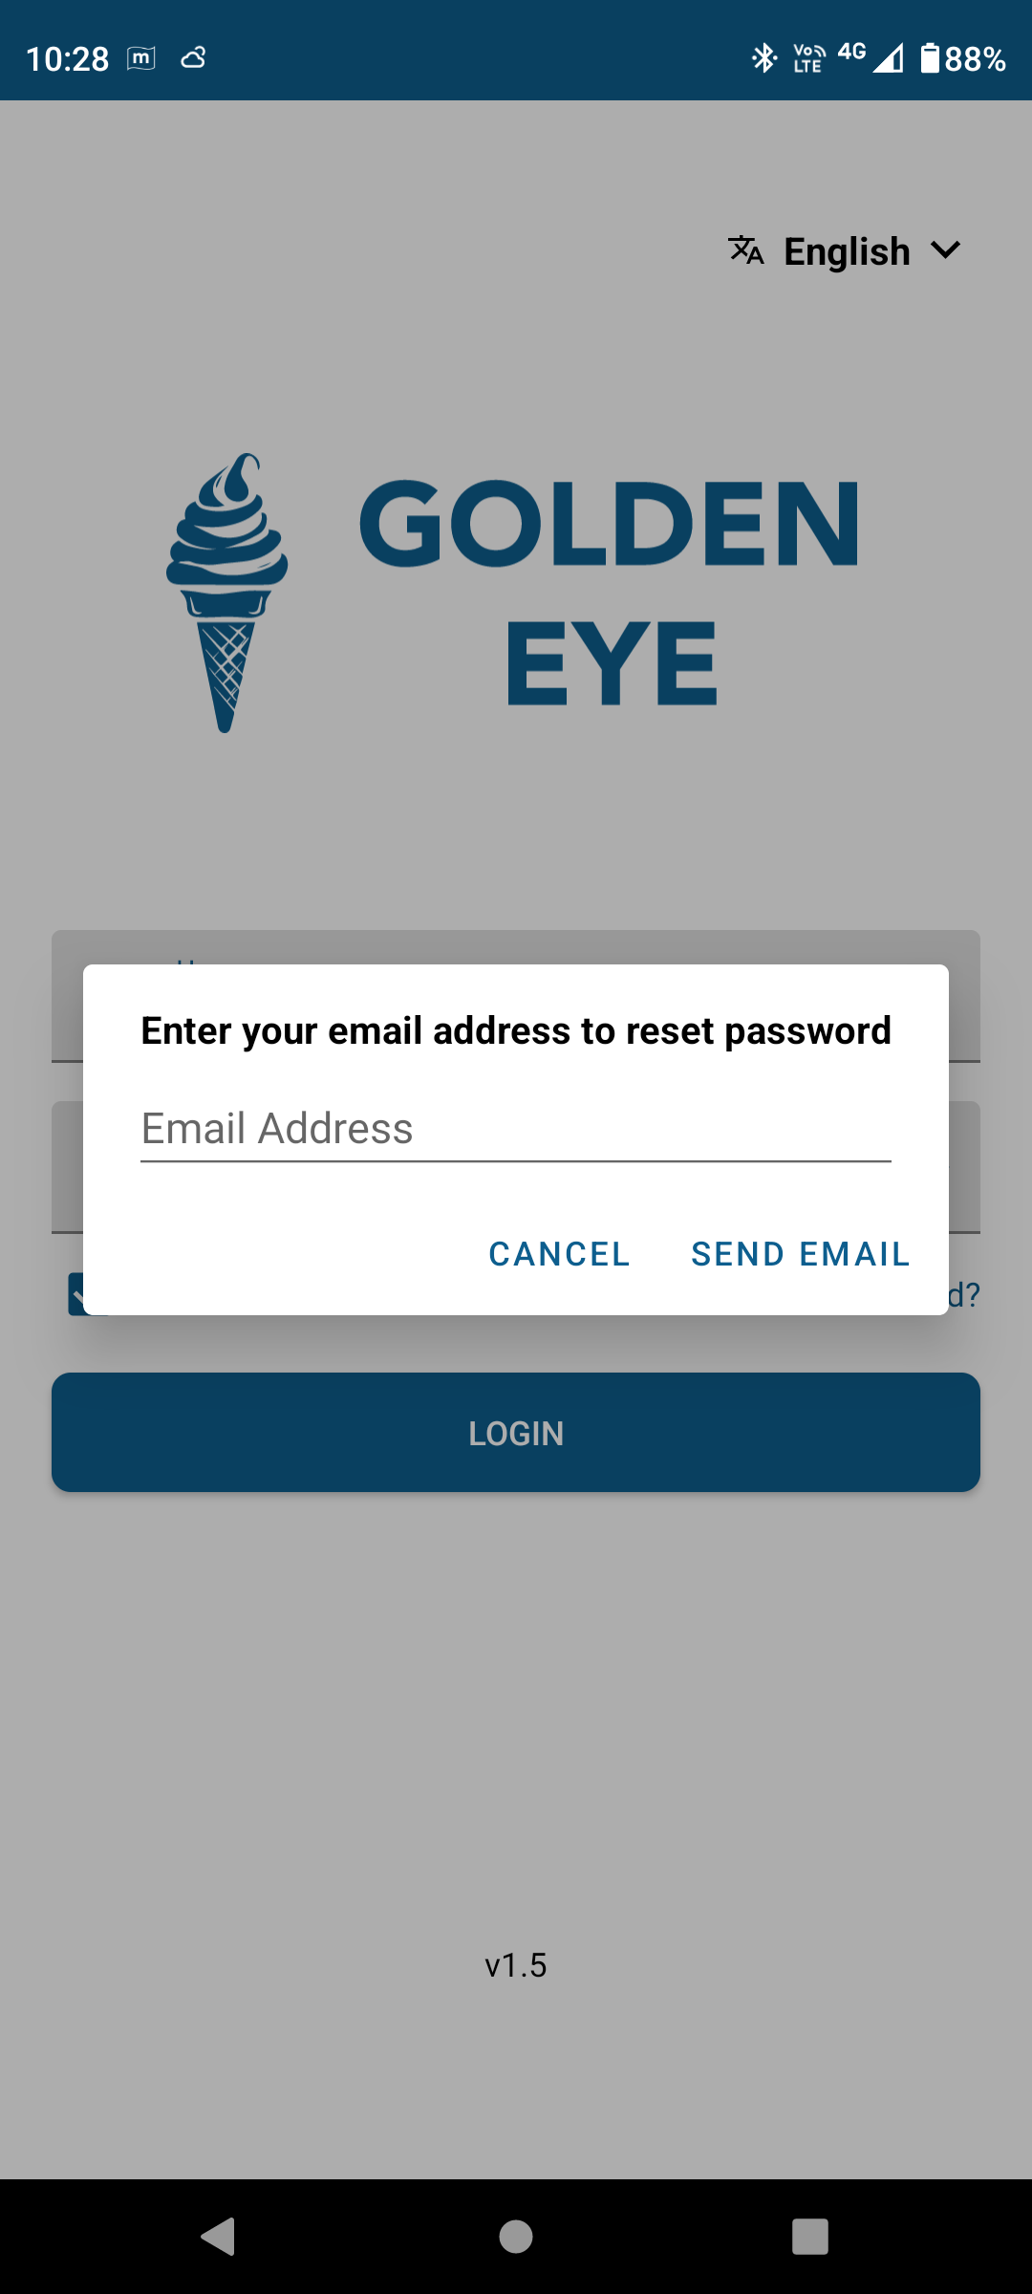
Application Login
Open Google Play store and search the Golden Eye application. Tap on the install button.
Allow Permission, to access the device’s location by tap on “while using the app” or “Only this time” options.
Please select your preferred language from the dropdown menu in the top right corner.
Enter valid credentials and tap on the Login button, To keep your credentials saved, check the box labeled "Remember Me."
Enter the registered Email address and tap on the send mail button to reset the password in case if you click on the Forget Password? Button.
© 2025 Vision Group

Slide 5
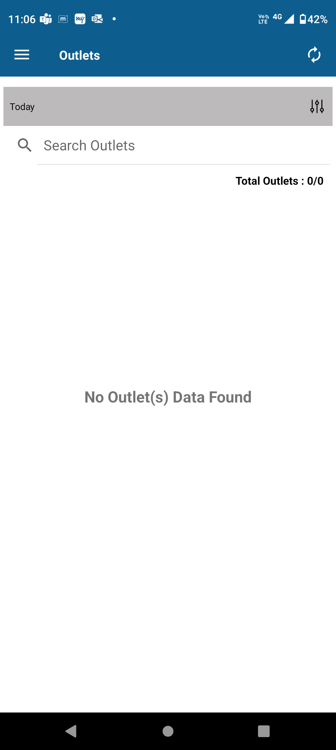
Outlet List
.
Outlet list screen will appear after the successful login.
This page will show the list of Outlets associated with the assets.
© 2025 Vision Group

Slide 6
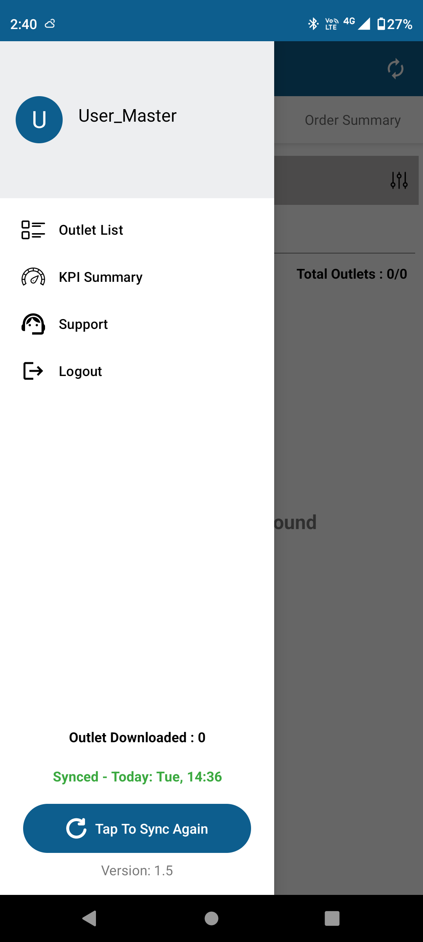
Menu Summary
.
Click on the hamburger menu from the outlet list page to view summary features such as the Outlet List, KPI Summary, Support, and Logout.
This also provides the Outlet Downloaded metric and a "Tap to Sync Again" button to refresh the current data.
© 2025 Vision Group

Slide 7
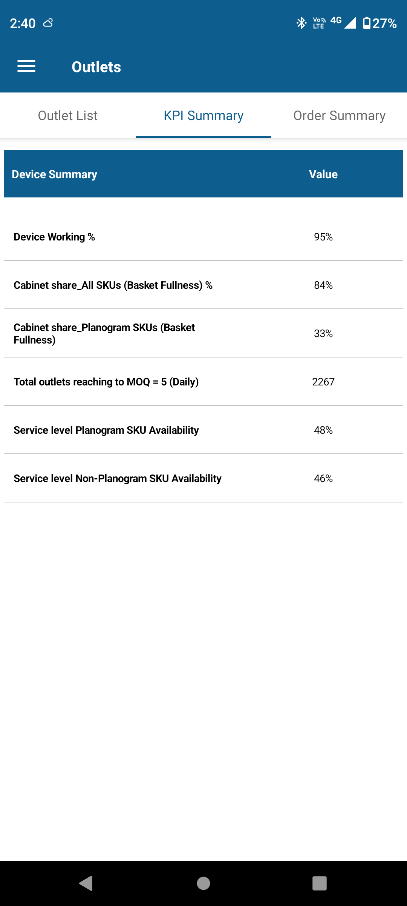
KPI Summary
.
Click on the KPI Summary option to view the details of the Device Summary.
This shows the values for Device Summary details along with values for Device Working%, Cabinet share_All SKUs (Basket Fullness)%, Cabinet share_Planogram SKUs (Basket Fullness), Total outlets reaching to MOQ=5 (Daily), Service level Planogram SKU Availability and Service level Non-Planogram SKU Availability.
© 2025 Vision Group

Slide 8
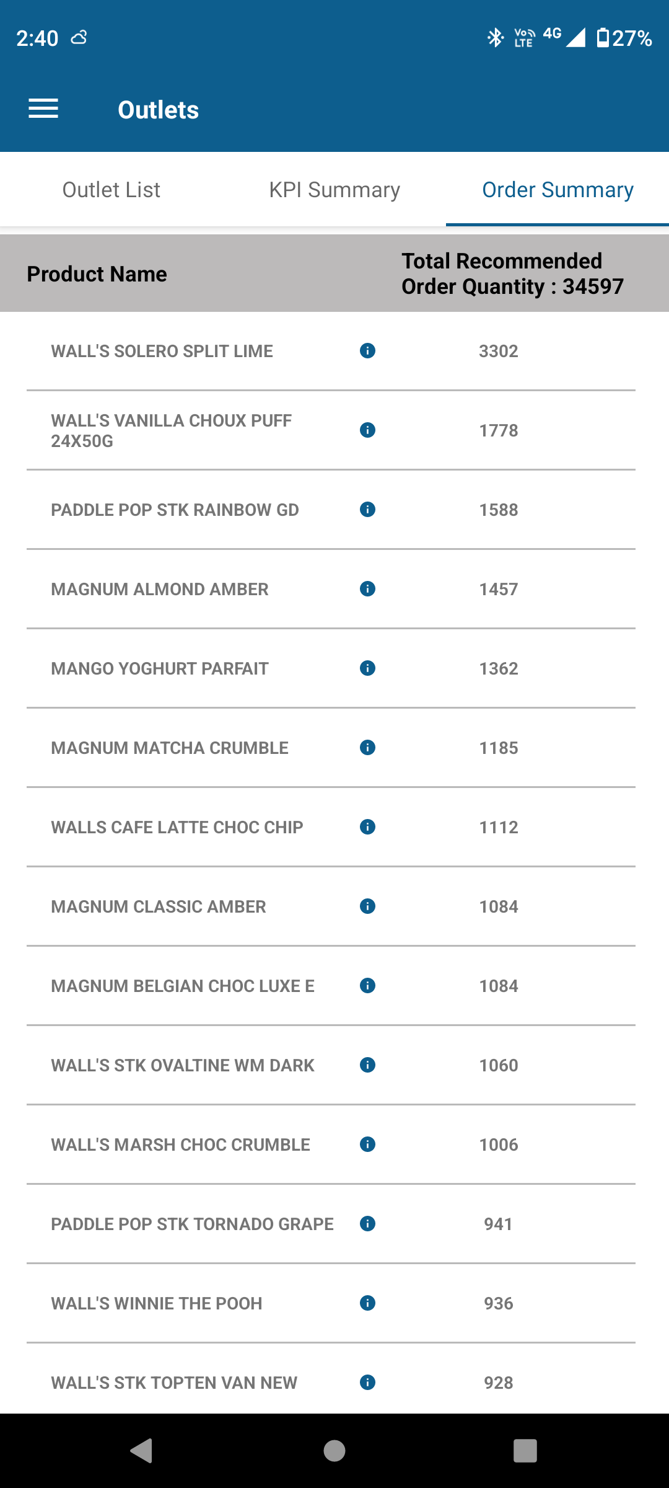
Order Summary
.
Click on the Order Summary tab option to view the details of the product list.
This shows the product list with Product name and its Total Recommended Order Quantity data.
Click the "i" icon next to the product name in the Basket Fullness list.
The new window will open, displaying the product image, name, SKU ID, and brand details.
© 2025 Vision Group

Slide 9
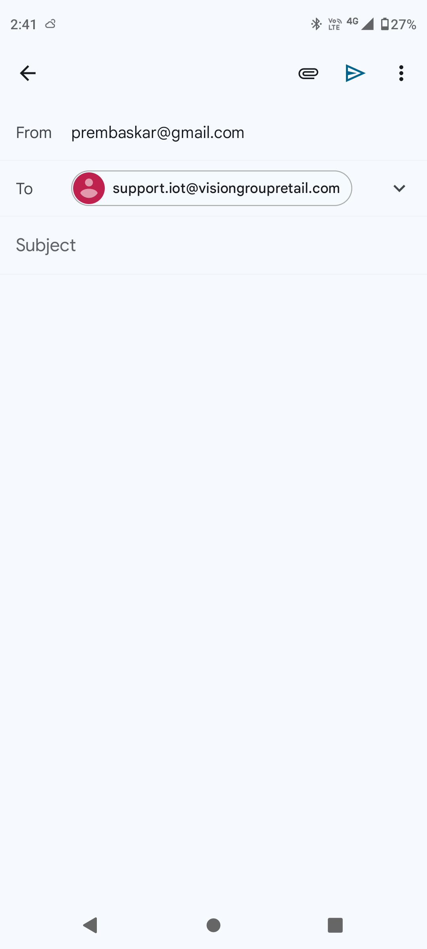
Support Email
.
Click the Support button on the Menu summary page to open a new window for drafting your help request or issue to send to the support team for resolution.
© 2025 Vision Group

Slide 10
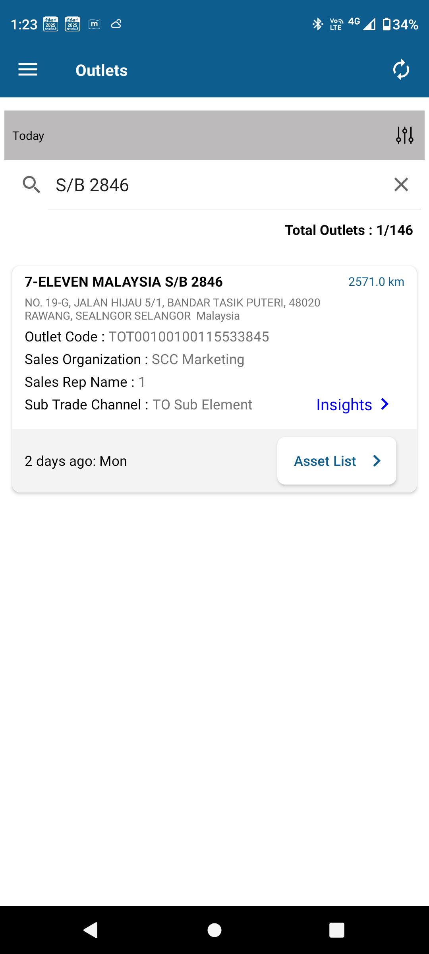
Search the Outlet
Enter the name of the Outlet in the search field to list the specific outlet.
Outlets will be listed with the details such as Outlet name, distance from the search location, address, Outlet Code, Sales Organization, Sales Rep Name and Sub Trade Channel, Insights and Asset List with updated day status.
© 2025 Vision Group

Slide 11
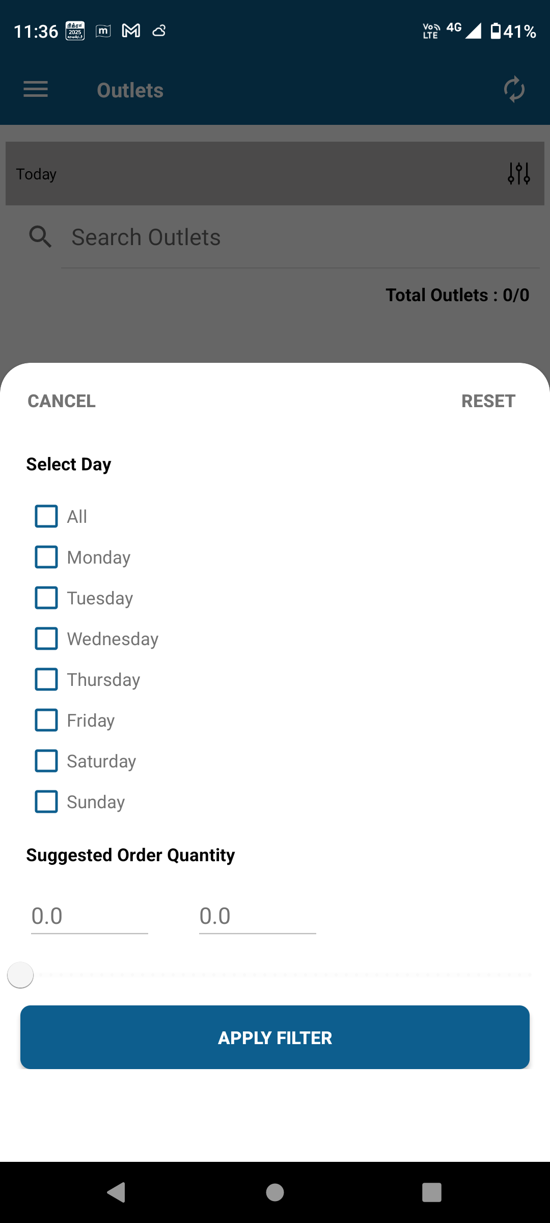
List the Outlets by using Filter Menu
Tap on the hamburger filter menu.
The new window will popup with Select Day option from Monday to Sunday and suggested Order Quantity options.
Outlets will be listed with the details such as Outlet name, distance from the search location, address, Outlet Code, Sales Organization, Sales Rep Name and Sub Trade Channel, Insights and Asset List with updated day status.
Reset and Cancel the selection of the existing day by tap on the CANCEL and REST buttons.
© 2025 Vision Group

Slide 12
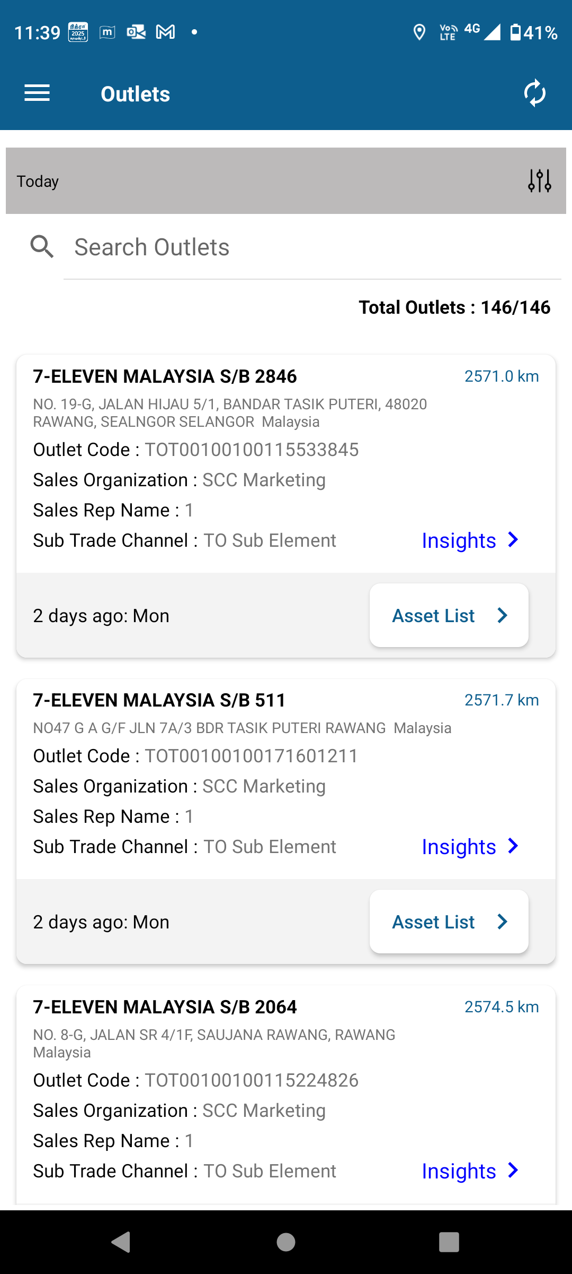
List the Outlets by tap refresh button
Tap on the refresh button.
All the recently created/updated Outlets will be listed.
© 2025 Vision Group

Slide 13
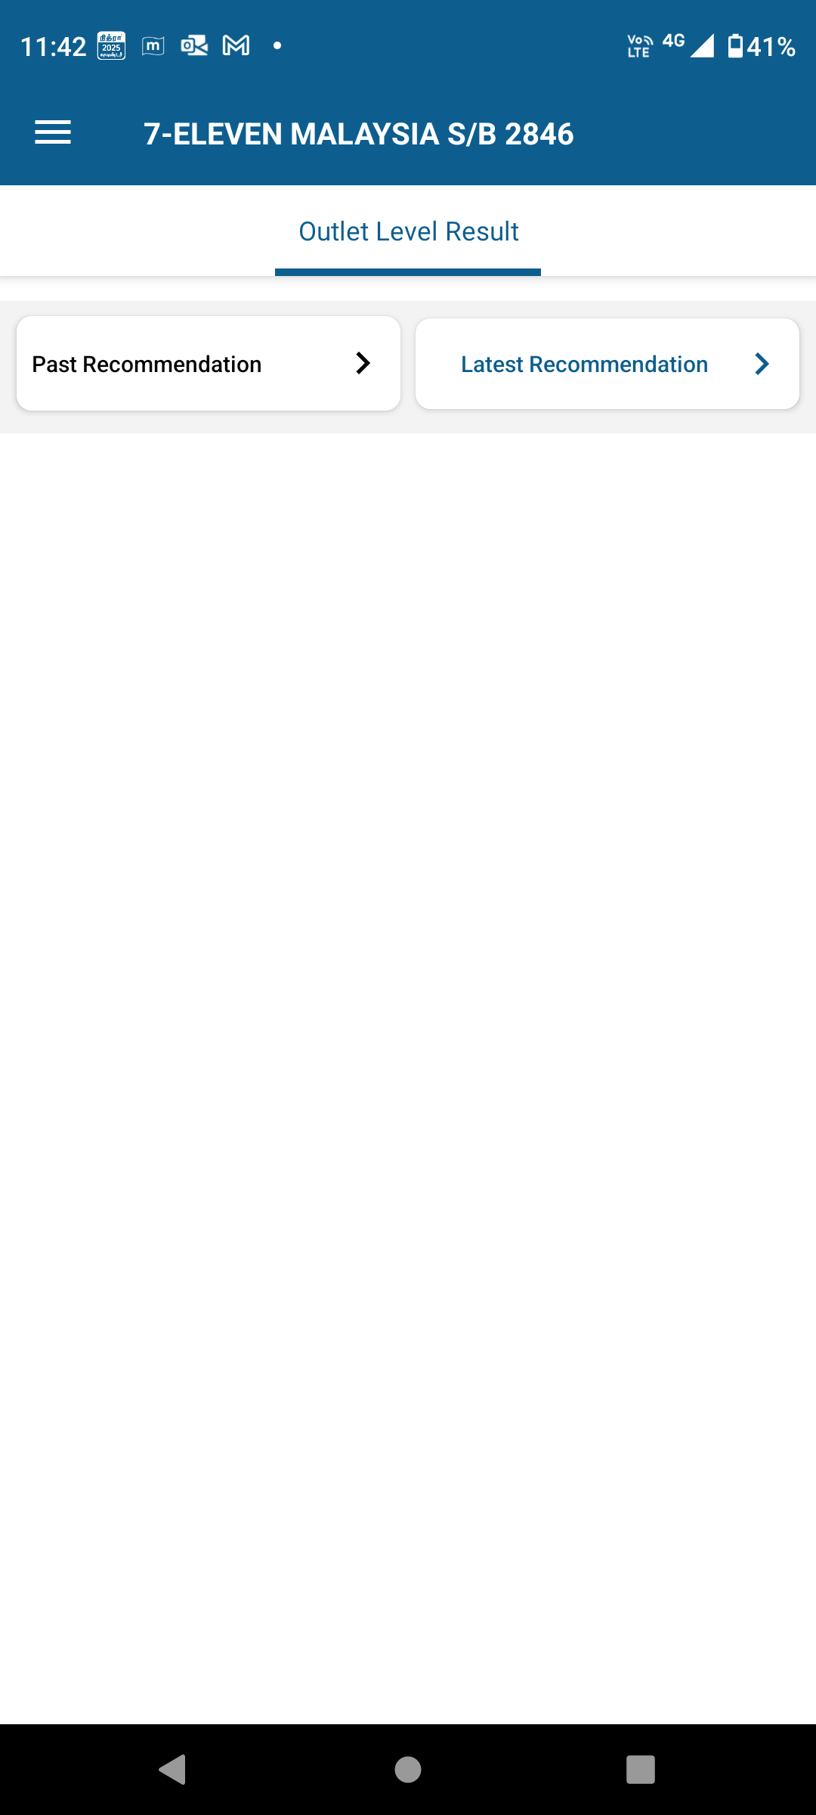
Insights screen
Click on the Insights button from the selected outlet.
The new window open and provides the Outlet Level Result.
© 2025 Vision Group

Slide 14
Past Recommendation
Tap on the Past Recommendation button.
© 2025 Vision Group

Slide 15
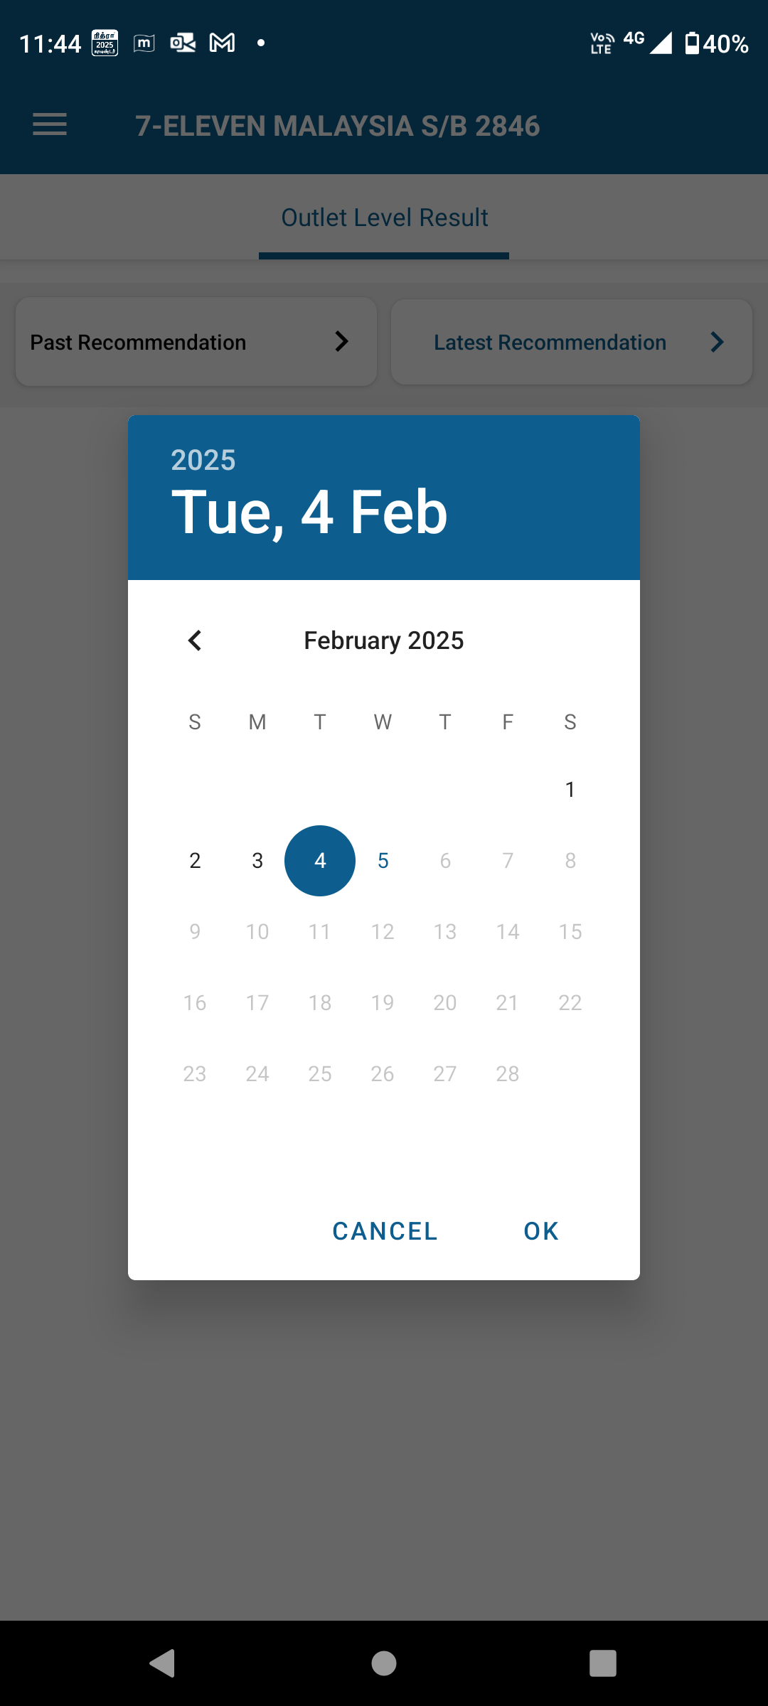
Past Recommendation
Click on the "Past Recommendations" button.
Select the desired past date, Click on OK button to view the basket fullness for the chosen outlet.
© 2025 Vision Group

Slide 16
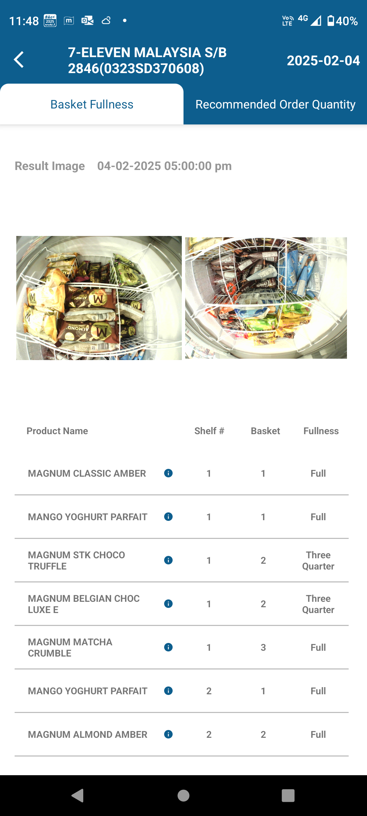
Basket Fullness
After selected the desired past date, Click on OK button to view the basket fullness for the chosen outlet.
The new window will open and provides the Basket Fullness details.
The Basket Fullness will show the result image of the products placed on the cooler with date and time, a list of products with product name, Shelf, Basket, and Fullness (as Full, Half, or Three Quarter, etc.)
© 2025 Vision Group

Slide 17
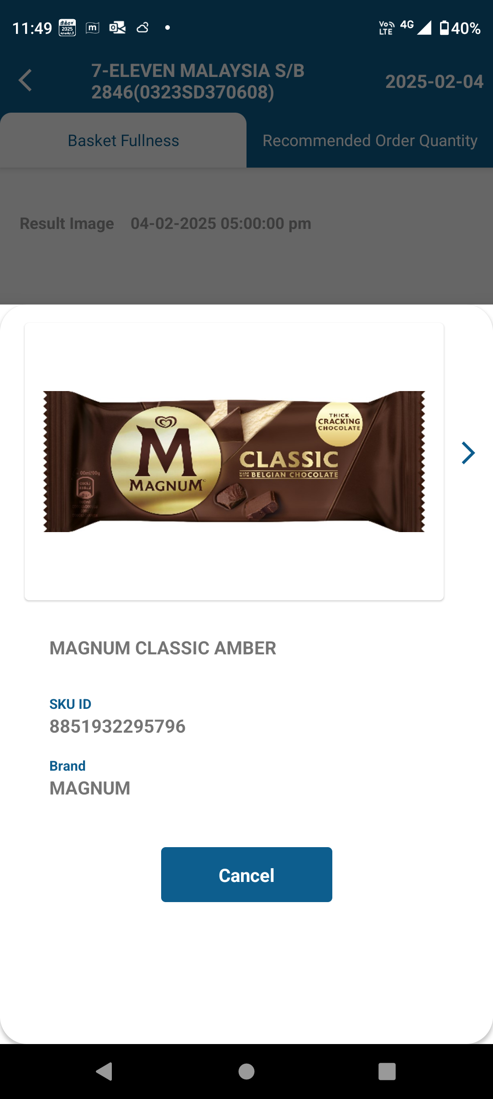
“i” icon provides product details
Click the "i" icon next to the product name in the Basket Fullness list.
The new window will open, displaying the product image, name, SKU ID, and brand details.
© 2025 Vision Group

Slide 18
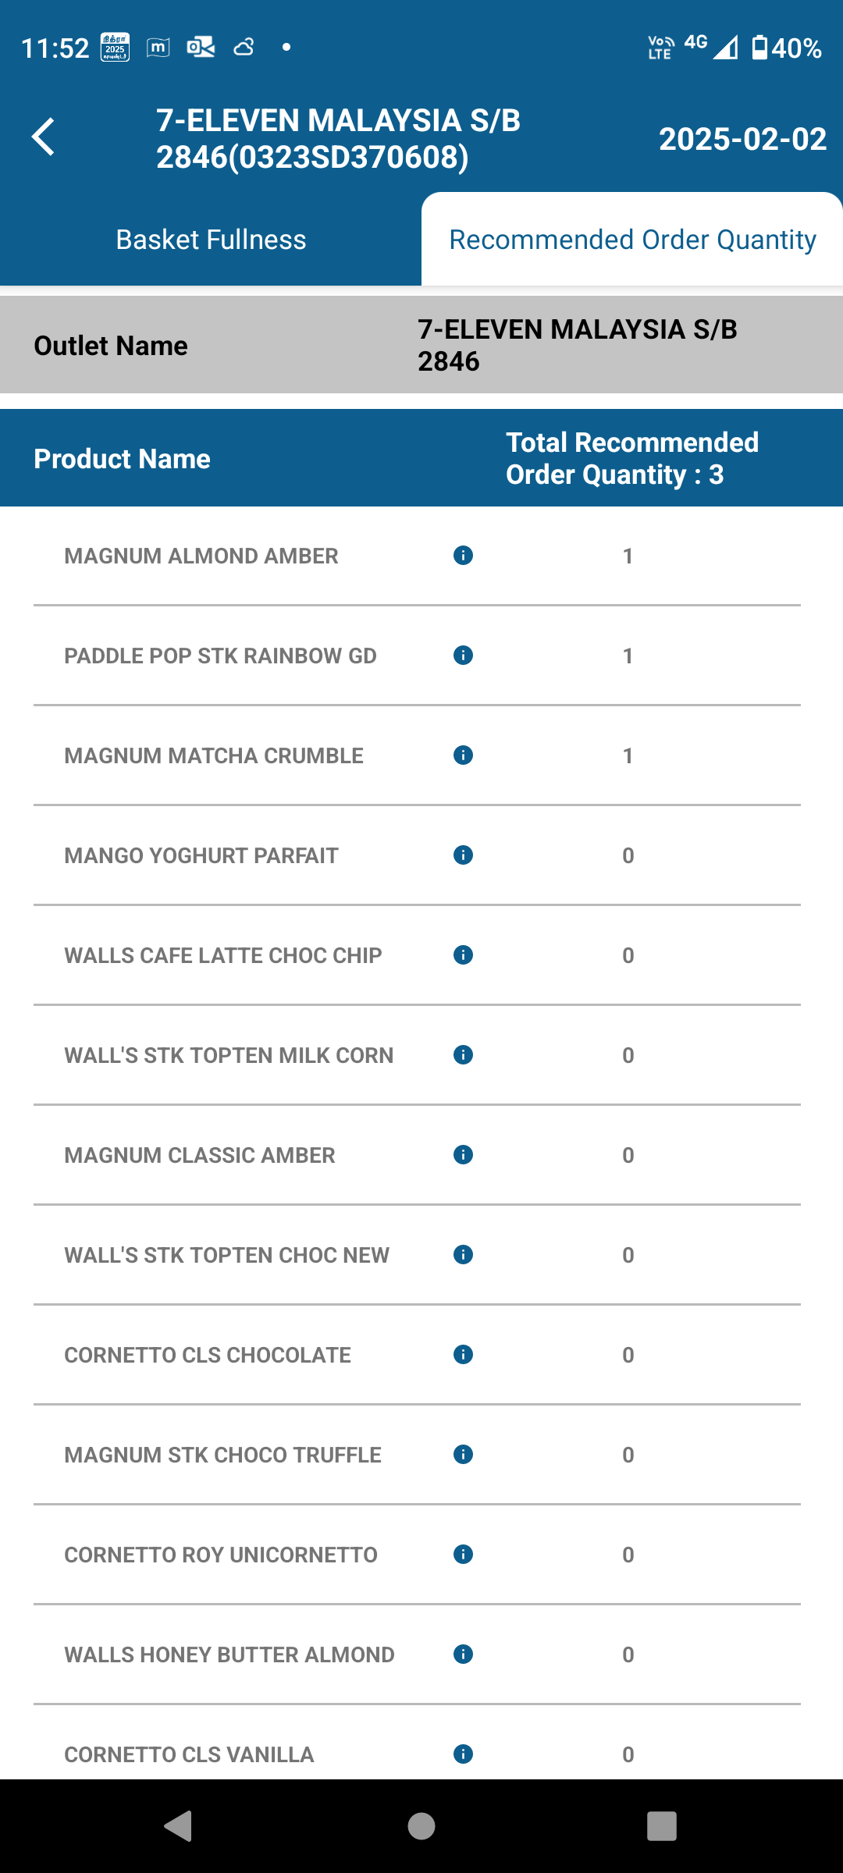
Recommended order quantity with product list
Tap on the Past Recommended order quantity button.
Then, the product list will be displayed with an updated total recommended order quantity.
Click the "i" icon next to the product name to view the product image, name, SKU ID, and brand details.
© 2025 Vision Group

Slide 19
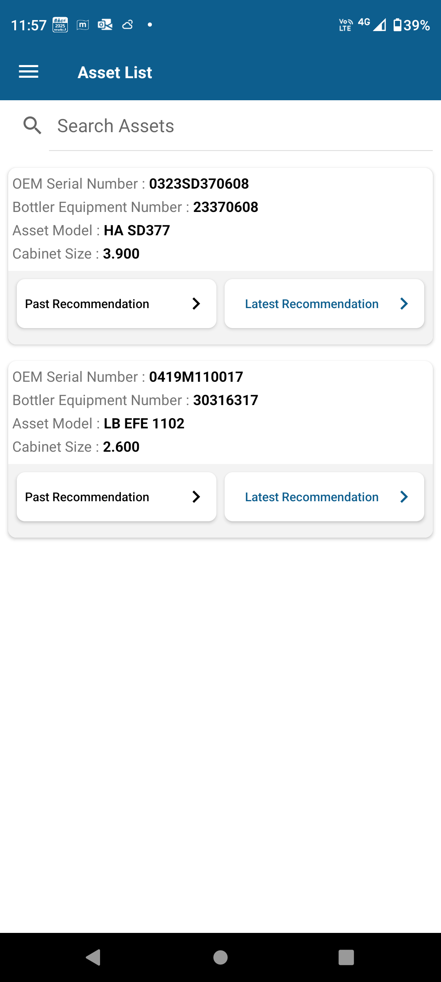
Asset List
Click on the Asset List button from the selected outlet.
The new window will display the asset details, including the OEM Serial Number, Bottler Equipment Number, Asset Model, and Cabinet Size, along with the Past Recommendation and the Latest Recommendation associated with the asset.
Please see the Past Recommendations slide for guidance on this feature; the same applies to the Latest Recommendations as well.
© 2025 Vision Group

Slide 20
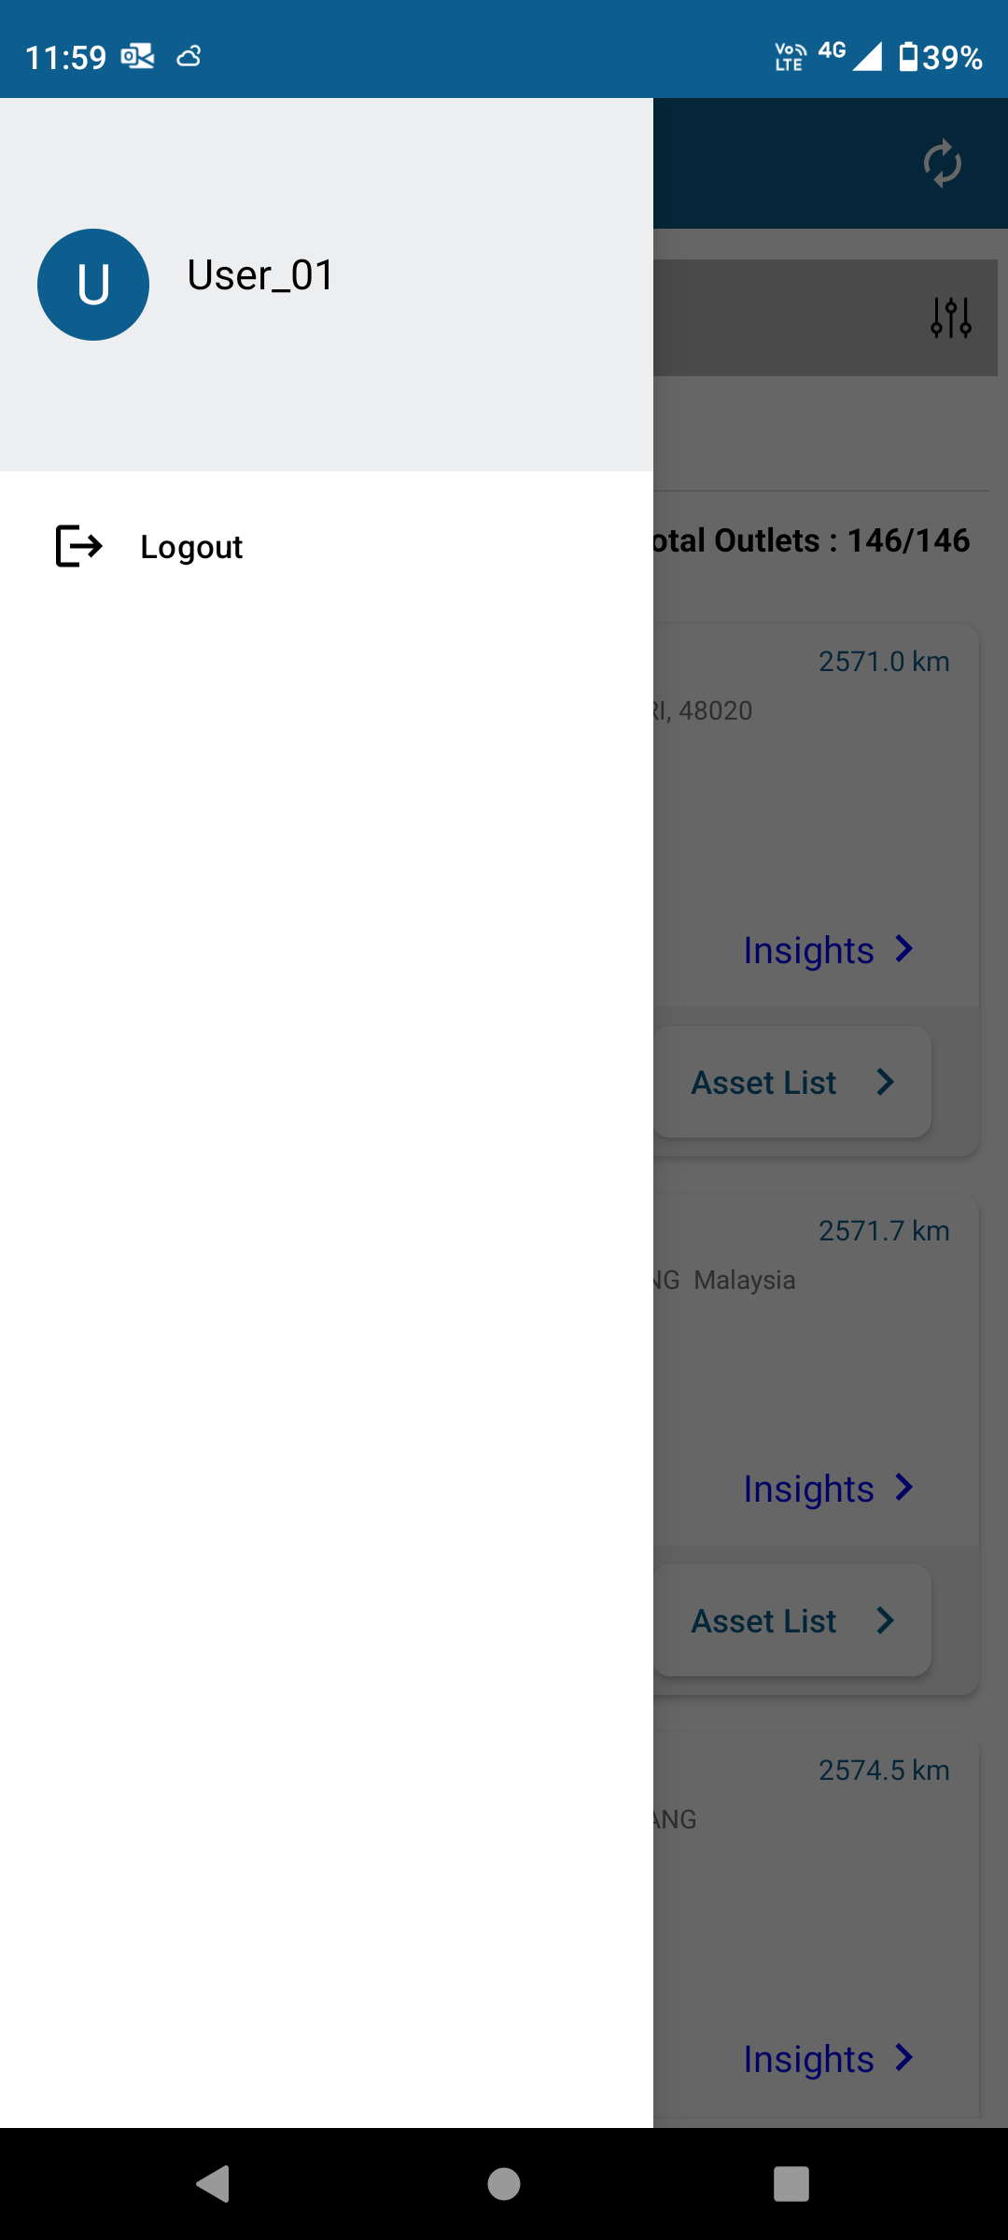
Logout
Click on the hamburger menu located at the top left of the application.
To exit the application, please tap on the Logout button.
© 2025 Vision Group

Slide 21


Thank You!
support.iot@visiongroupretail.com
+1-833-593-0144 (USA Tollfree Number)
© 2023 Vision Group

